Slide 1

Text Analytics
Teoh Teik Toe
ITOM/NBS
ttteoh@ntu.edu.sg
97905202

Slide 2
Agenda
Text Sentiment
R
Python
Transformer
Text Classification & Clustering (Embedding)
Vectorization
TFIDF
BERT
Web Crawler
Chatbot

Slide 3
Text Analytics
Text Sentiment
Python - Textblob
R – Afinn
Text Classification & Clustering
Chatbot
Transformer – Pipeline
Embedding – SKLearn (No of words in document)
Embedding – TFIDF (No of words in document)
Embedding – BERT by Google (768)
Transformer – Facebook
Orange – FastText (300)
WebCrawler – Beautiful Soup & NLTK
Code: https://drive.google.com/drive/folders/1fXjR7HWQVDvW4b_UwFmEM_NymlOo4Wbw?usp=sharing
Data:
https://drive.google.com/drive/folders/1DWSSkL9zMwXktar8rxC_3rUGqxwNNTrR?usp=sharing

Slide 4
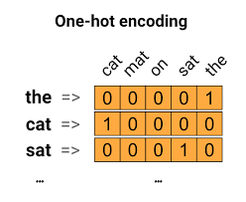
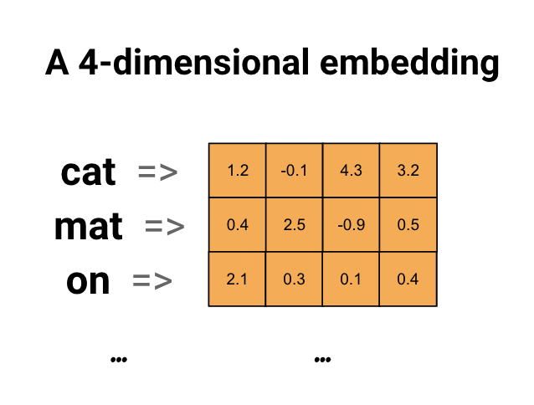
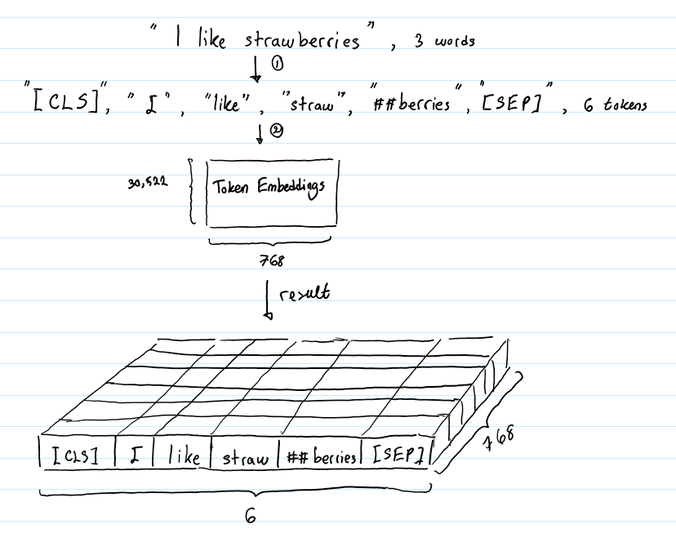
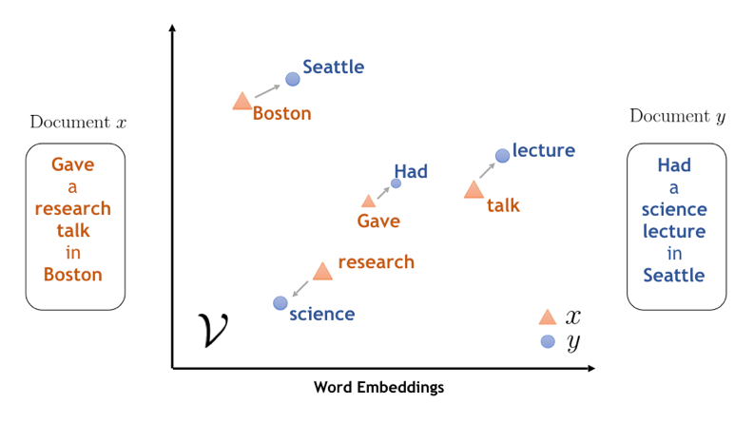
Text Embedding (Converting the unstructured data to structured data)

Slide 5
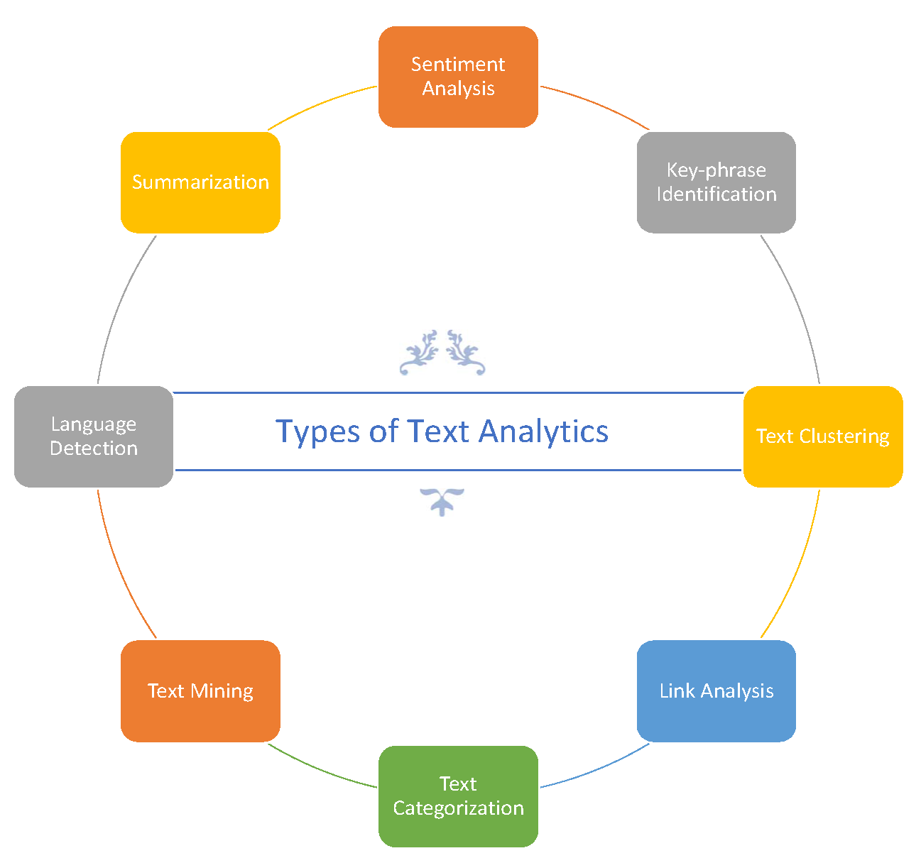
https://medium.com/@tag.kumail/text-analysis-in-microsoft-azure-and-power-bi-e07276232d6c

Slide 6

Text Analytics on Business Valuation
Auto Crawler
Sentiment Analysis
Macro Economic (Country)
Micro Economic (Industry)
Competitor
Company

Slide 7


NLP
Natural language processing (NLP) is a subfield of linguistics, computer science, information engineering, and artificial intelligence
Challenges in natural language processing frequently involve speech recognition, natural language understanding, and natural language generation.

Slide 8
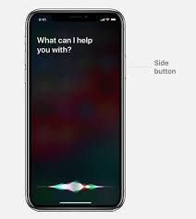
Application
Speech Recognition
Text to Speech
Generating Reports
Chatbot
Check document
Alibaba Chatbot 350m enquiries per day
Siri
Google Nest

Slide 9


Natural Language Processing Libraries
NLTK (Python)
NLP (R)
Google News Corpus
Scrapping, Tokenization, Stemming and Lemmatization, Part-Of-Speech (Structure the Unstructured), Classifier

Slide 10
Text Sentiment

Slide 11
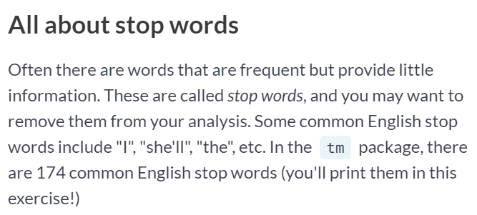
Remove stopwords

Slide 12
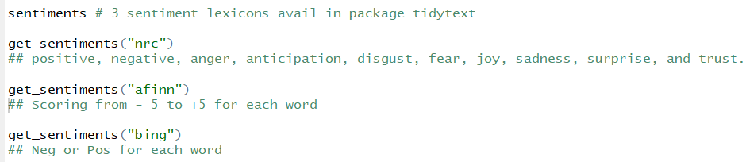
Sentiments in tidytext : nrc, afinn, bing

Slide 13

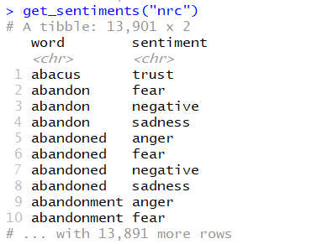
Sentiment: nrc

Slide 14
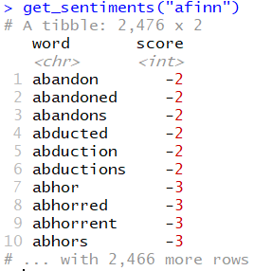
Sentiment: afinn

Slide 15

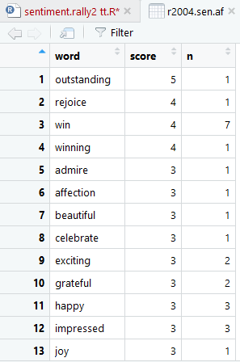
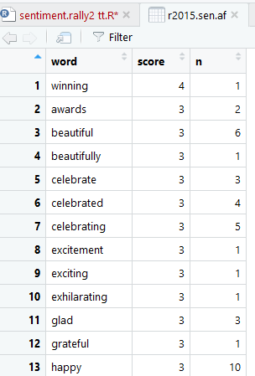
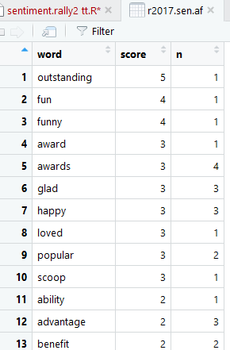
Afinn

Slide 16
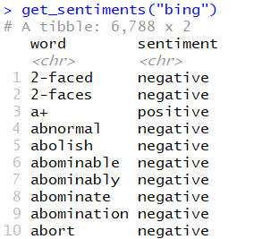
Sentiment : Bing

Slide 17
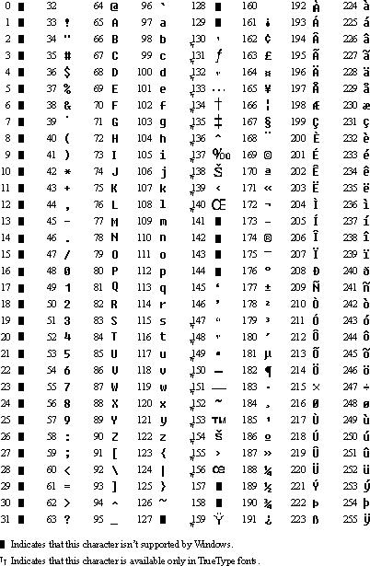
ANSI

Slide 18
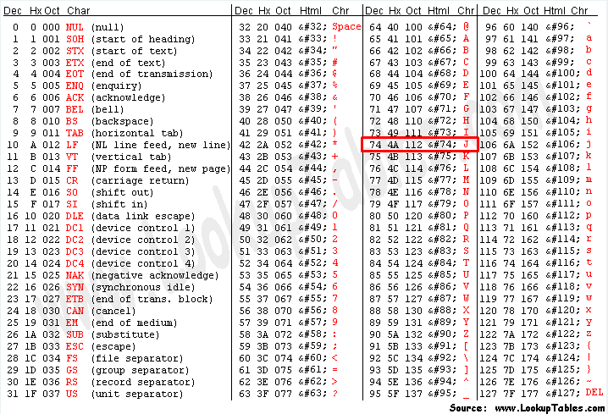
ANSI vs UTF

Slide 19
R Code
The pipe, %>% in R for text movement
library(dplyr)
library(tidytext)
library(textdata)
#data(stop_words)
#text <- readLines(“Tesla News.txt", encoding = "UTF-8")
d = readLines(".txt")
d = data_frame(text = d) #data frame in dplyr library
d = d %>% unnest_tokens(word, text) # tidy text
d = d %>% anti_join(stop_words) #anti join in dplyr library
# %>% arrange(desc(value))
get_sentiments("afinn")
d = d %>% inner_join(get_sentiments("afinn")) #inner join in dplyr library
d= d %>% count(word, value)
d = d %>% summarise(sum(value*n))
print(d)

Slide 20
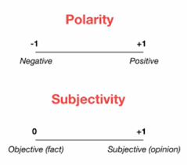
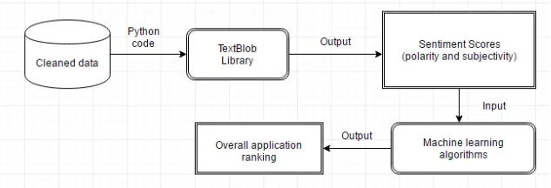
Text Sentiment by Textblob

Slide 21
Python (Text Sentiment)
#!pip install textblob
from textblob import TextBlob
f1 = "the food is good"
f2 = "the food is superb"
b1 = TextBlob(f1)
b2 = TextBlob(f2)
print(b1.sentiment)
print(b2.sentiment)
https://textblob.readthedocs.io/en/dev/#:~:text=TextBlob%20is%20a%20Python%20(2,classification%2C%20translation%2C%20and%20more.

Slide 22
Sentiment from file
pip install textblob
from textblob import TextBlob
d = input("please enter the text : ")
TextBlob(d).sentiment
Alternatively
#open text file in read mode
f = open("Tesla News.txt")
#read whole file to a string
d = f.read()
import io
f = io.open("rally2004U.txt", mode="r", encoding="utf-8")

Slide 23
Front End
<html>
<body>
<h1>Text Sentiment Analysis</h1>
<form action="/" method="post">
<p>Please enter your text: </p>
<p><input type="text" name="text"></p>
<p><input type="submit" value="Enter"></p>
</form>
{{result}}
</body>
</html>

Slide 24
Back End
from textblob import TextBlob
from flask import Flask
app = Flask(__name__)
from flask import render_template,request
@app.route("/", methods=["GET", "POST"])
def index():
if request.method == "POST":
text = request.form.get("text")
print(text)
r = TextBlob(text).sentiment
return(render_template("index.html", result=r))
else:
return(render_template("index.html", result="2"))
if __name__=="__main__":
app.run()
If 5000 cannot work
if __name__ == '__main__':
app.run(host='0.0.0.0', port=80)

Slide 25
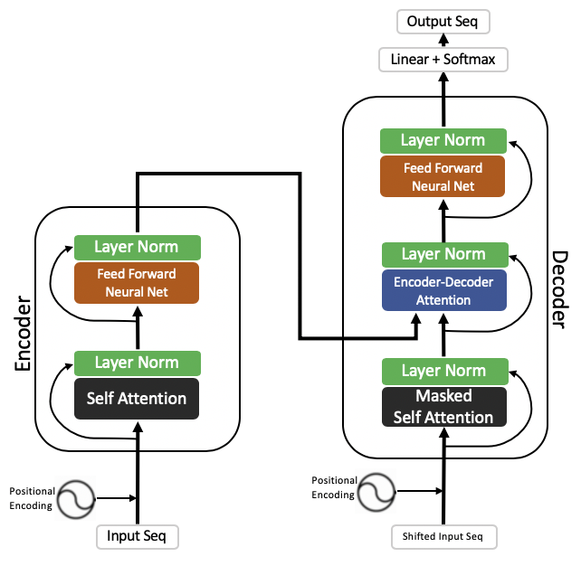
Transformer, Encoder, Attention RNN

Slide 26
Transformer – Sentiment Analysis
#pip install transformers
from transformers import pipeline
classifier = pipeline("sentiment-analysis")
text = input("Please input your text for sentiment analysis : ")
classifier(text)
Pipelines
The pipelines are a great and easy way to use models for inference. These pipelines are objects that abstract most of the complex code from the library, offering a simple API dedicated to several tasks, including Named Entity Recognition, Masked Language Modeling, Sentiment Analysis, Feature Extraction and Question Answering.

Slide 27
Text Classifier
import requests
url = “”
movie_data = load_files(requests.get(url, stream=True).raw)

Slide 28
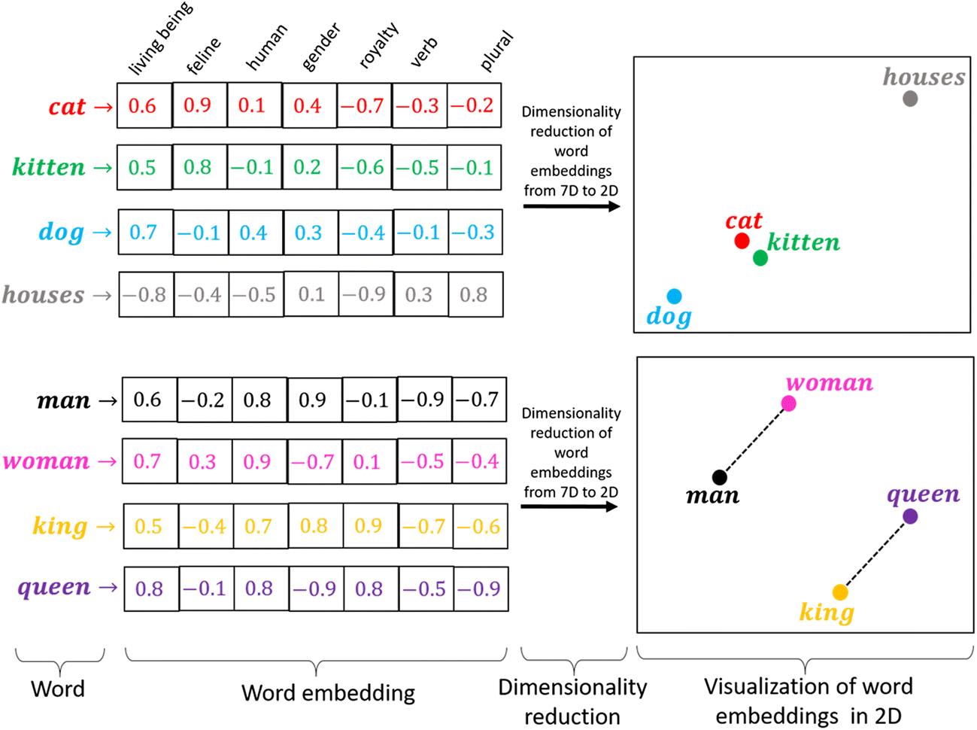
Word 2 Vec

Slide 29
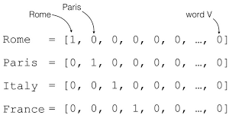
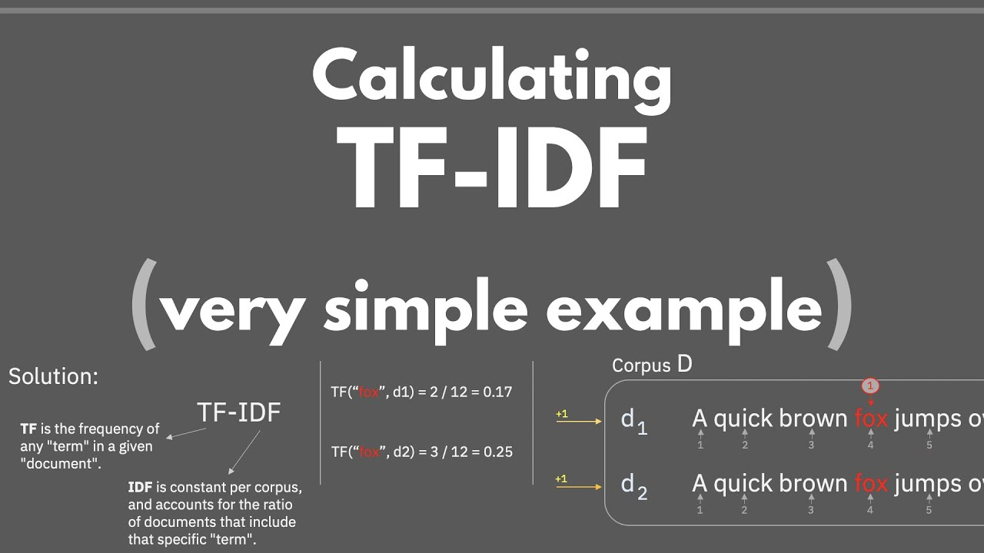
TFIDF

Slide 30
import pandas as pd
#df=pd.read_json("/content/drive/MyDrive/TT Library/AI Model/Data/news category.json", lines=True)
df = pd.read_csv("News Category (Text) for Orange.csv")
#df = df[df['category'].isin(['CRIME','COMEDY'])]
y = df['category']=='CRIME'
X =df['headline'].tolist()
from sklearn.feature_extraction.text import CountVectorizer
X_CV = CountVectorizer().fit_transform(X)
from sklearn.model_selection import train_test_split
X_train, X_test, y_train, y_test = train_test_split(X_CV, y)
from sklearn.linear_model import LogisticRegression
from sklearn.metrics import confusion_matrix
model = LogisticRegression()
model.fit(X_train, y_train)
pred = model.predict(X_test)
cm=confusion_matrix(y_test, pred)
acc=(cm[0,0]+cm[1,1])/sum(sum(cm))
print('Accuracy without TFIDF is ', acc)
News Category
Using SKLearn CountVec

Slide 31
from sklearn.feature_extraction.text import TfidfTransformer
X_train = TfidfTransformer().fit_transform(X_train)
X_test = TfidfTransformer().fit_transform(X_test)
model = LogisticRegression()
model.fit(X_train, y_train)
pred = model.predict(X_test)
cm=confusion_matrix(y_test, pred)
acc=(cm[0,0]+cm[1,1])/sum(sum(cm))
print('Accuracy with TFIDF is ',acc)
News Category
Using TFIDF

Slide 32
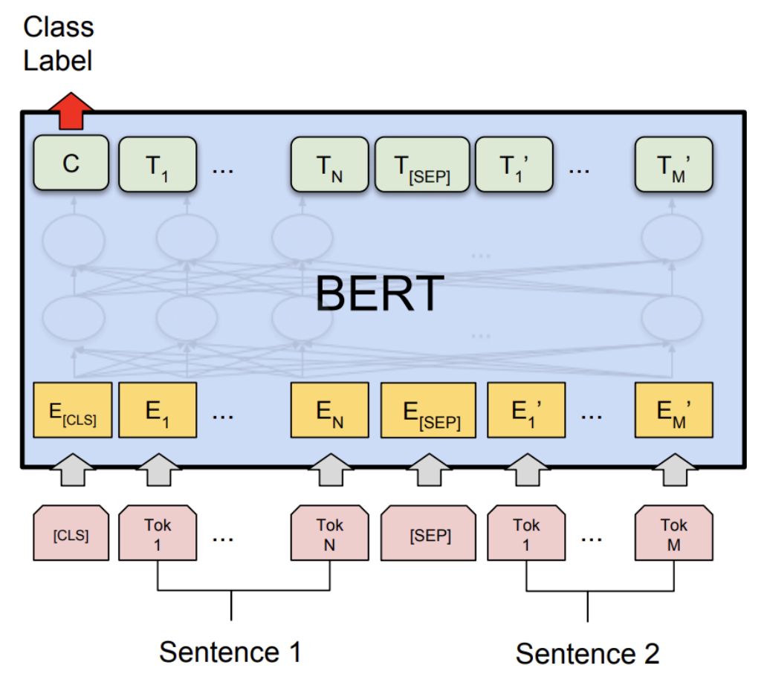
BERT
Bidirectional Encoder Representations from Transformers (BERT) is a transformer-based machine learning technique for natural language processing (NLP) pre-training developed by Google

Slide 33
#for colab
pip install sentence_transformers
from sentence_transformers import SentenceTransformer
model = SentenceTransformer('bert-base-nli-mean-tokens')
X_emb = model.encode(X)
from sklearn.model_selection import train_test_split
X_train, X_test, y_train, y_test = train_test_split(X_emb, y)
from sklearn.linear_model import LogisticRegression
from sklearn.metrics import confusion_matrix
model = LogisticRegression()
model.fit(X_train, y_train)
pred = model.predict(X_test)
cm=confusion_matrix(y_test, pred)
acc=(cm[0,0]+cm[1,1])/sum(sum(cm))
print('Accuracy using Bert is ', acc)
News Category
Using BERT

Slide 34
Text Clustering – News Category
from sklearn.cluster import KMeans
model = KMeans(n_clusters=2)
model.fit(X_emb)
pred = model.predict(X_emb)
cm = confusion_matrix(y, pred)
from yellowbrick.cluster import KElbowVisualizer
v = KElbowVisualizer(model,k=(2,10))
v.fit(X_emb)
v.show()

Slide 35
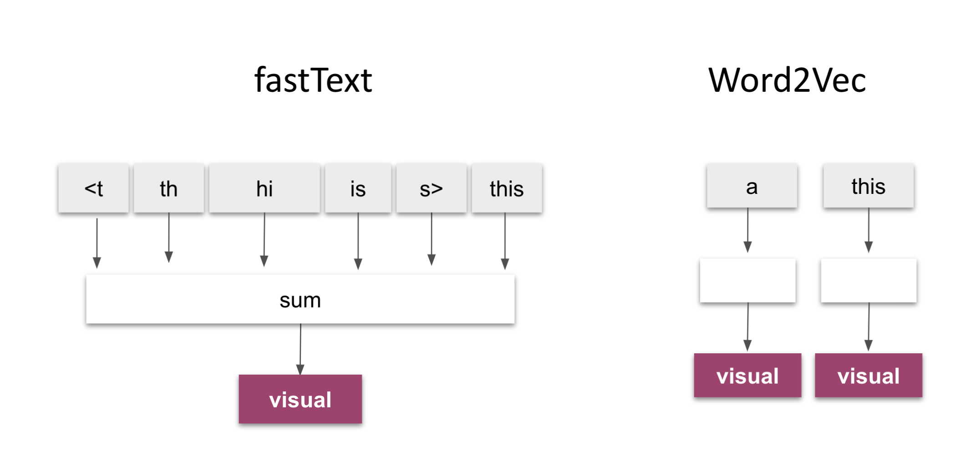
Orange Text Classification – FastText

Slide 36
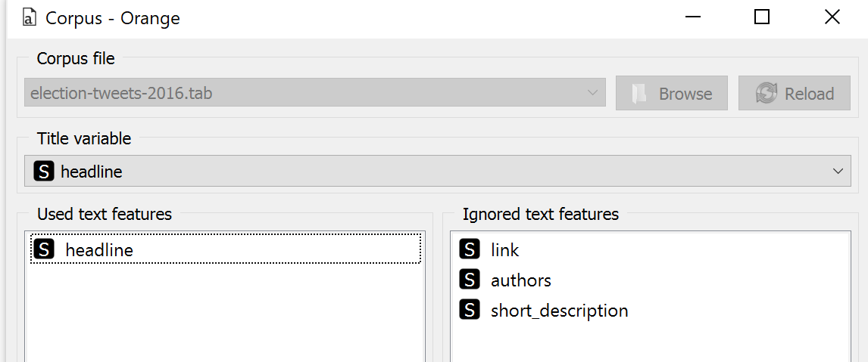
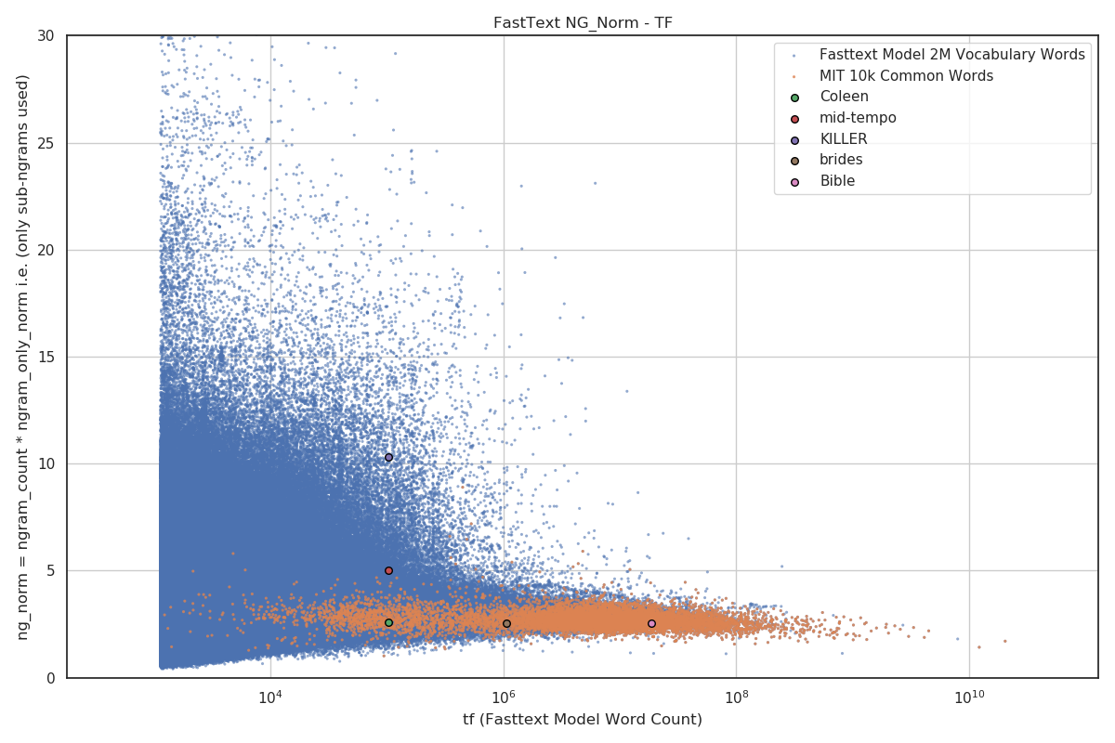
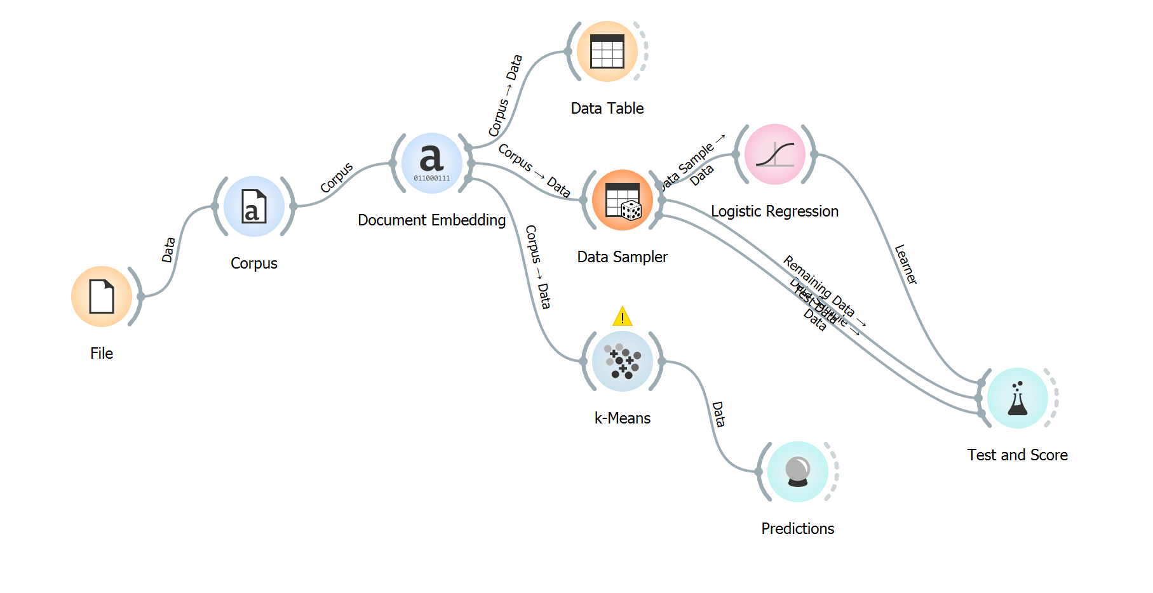
Compare to ORANGE – News Category
Clustering

Slide 37
Movie Review
https://www.cs.cornell.edu/people/pabo/movie-review-data/

Slide 38
https://stackabuse.com/text-classification-with-python-and-scikit-learn/
from sklearn.datasets import load_files
d = load_files(r"C:\Users\Teoh Teik Teo\OneDrive - TSS Global Pte. Ltd\TT Library\AI Model\Data\Movie Review (Text)")
X, Y = d.data, d.target
from sklearn.feature_extraction.text import CountVectorizer
X_CV = CountVectorizer().fit_transform(X)
from sklearn.model_selection import train_test_split
X_train, X_test, Y_train, Y_test = train_test_split(X_CV, Y)
from sklearn.linear_model import LogisticRegression
from sklearn.metrics import confusion_matrix
model = LogisticRegression()
model.fit(X_train, y_train)
pred = model.predict(X_test)
cm=confusion_matrix(y_test, pred)
print(cm)
acc=(cm[0,0]+cm[1,1])/sum(sum(cm))
print('Accuracy without TFIDF is ', acc)

Slide 39
from sklearn.feature_extraction.text import TfidfTransformer
X_train = TfidfTransformer().fit_transform(X_train)
X_test = TfidfTransformer().fit_transform(X_test)
model = LogisticRegression()
model.fit(X_train, y_train)
pred = model.predict(X_test)
cm=confusion_matrix(y_test, pred)
acc=(cm[0,0]+cm[1,1])/sum(sum(cm))
print('Accuracy with TFIDF is ',acc)

Slide 40
Text Clustering – Movie Review
from sklearn.cluster import KMeans
model = KMeans(n_clusters=2)
model.fit(X)
pred = model.predict(X)
cm = confusion_matrix(y, pred)
from yellowbrick.cluster import KElbowVisualizer
v = KElbowVisualizer(model,k=(2,10))
v.fit(X)
v.show()

Slide 41
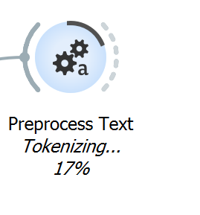
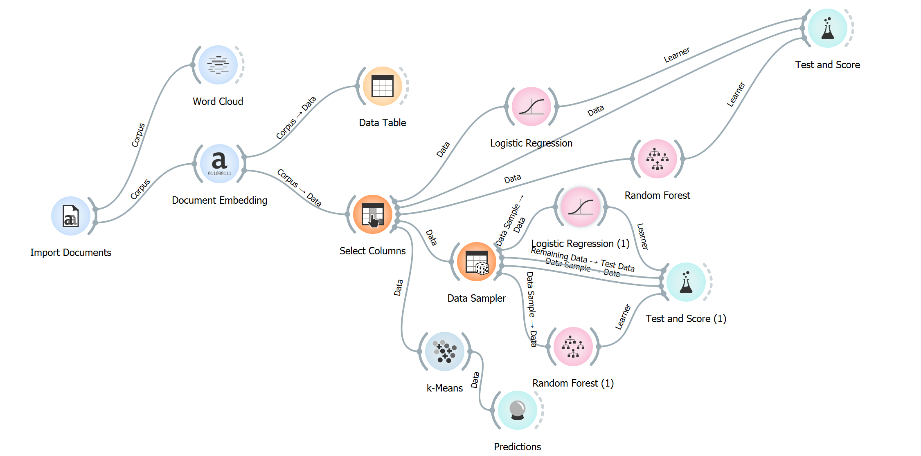
Movie Review - Orange
Without Splitting
Clustering

Slide 42
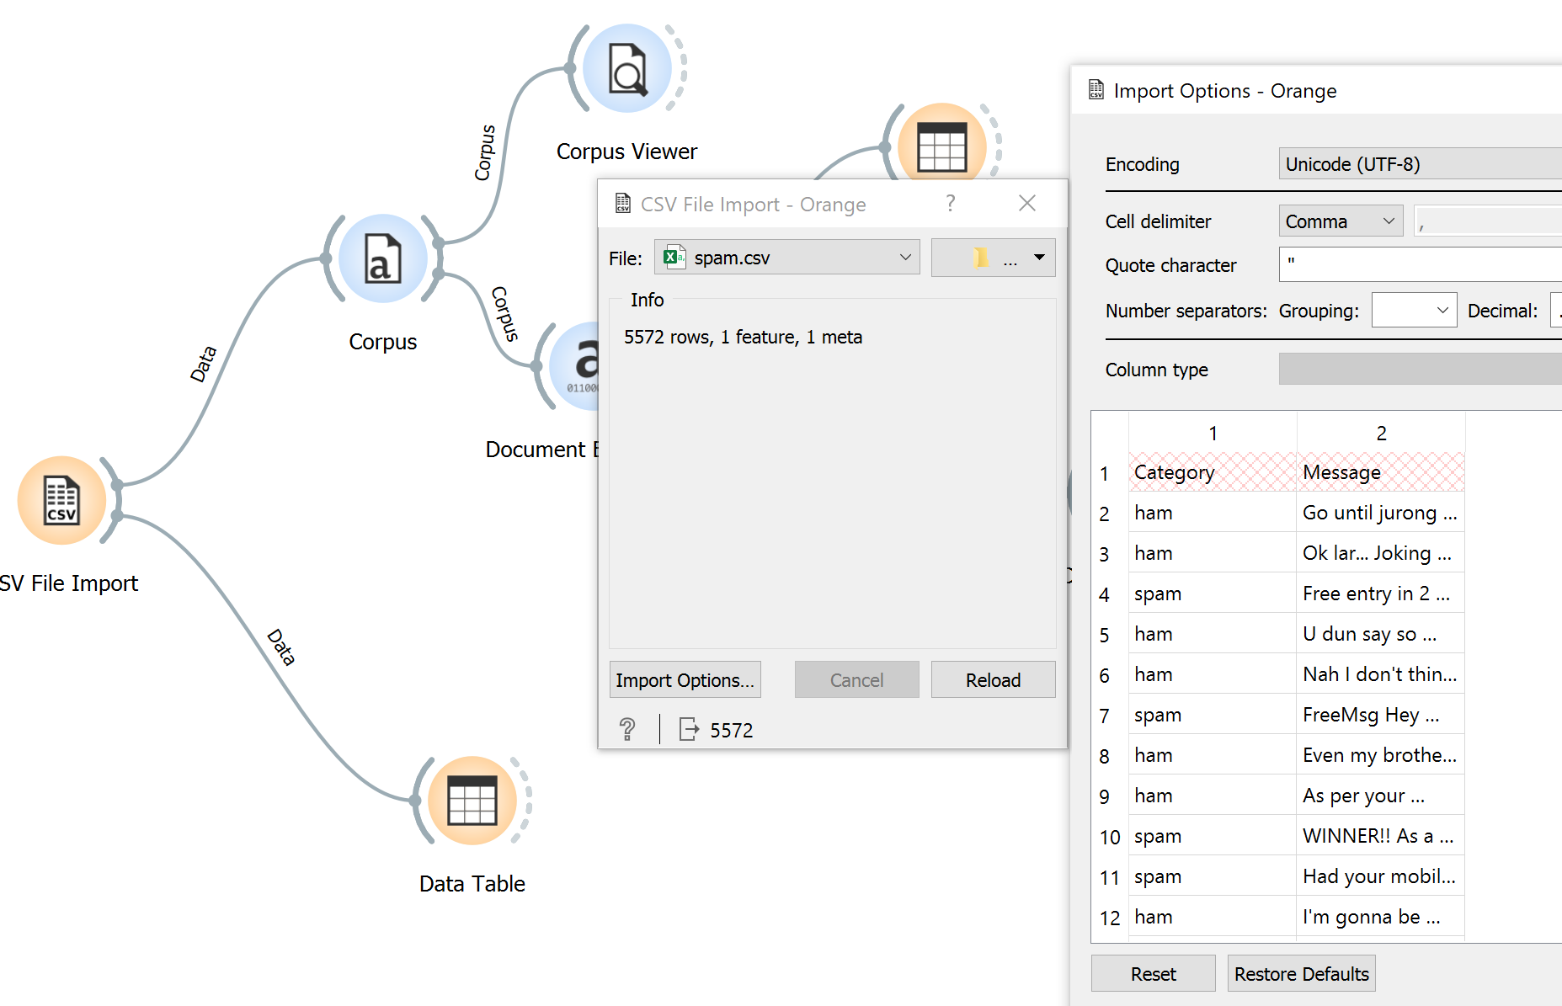
Spam – remove first row

Slide 43
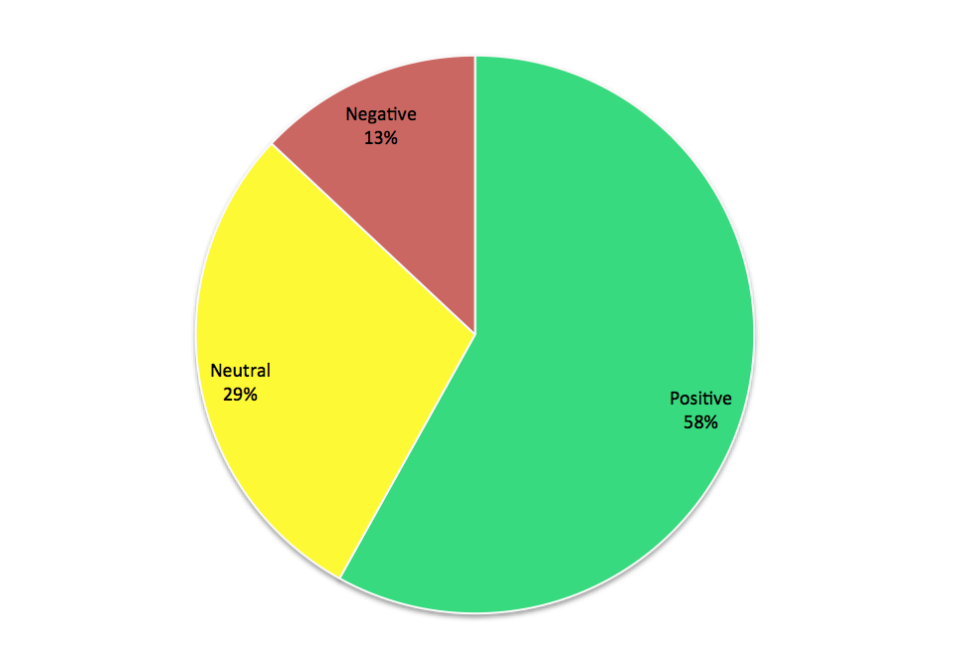

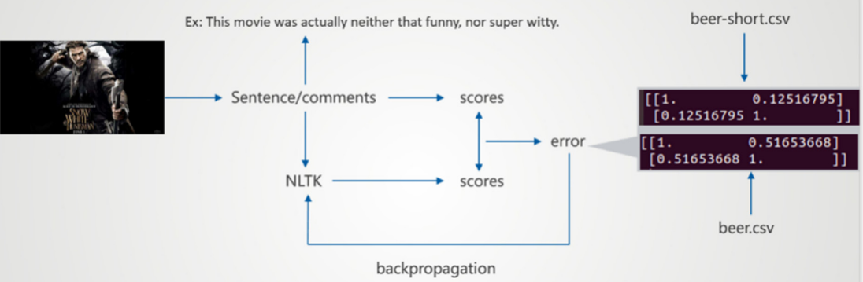
Web Crawling with Sentiment Analysis

Slide 44
import urllib
import requests
from bs4 import BeautifulSoup
from nltk.sentiment import SentimentIntensityAnalyzer
import nltk
from pprint import pprint
def main(q):
nltk.downloader.download('vader_lexicon',quiet=True)
sia = SentimentIntensityAnalyzer()
# desktop user-agent
USER_AGENT = "Mozilla/5.0 (Macintosh; Intel Mac OS X 10.14; rv:65.0) Gecko/20100101 Firefox/65.0"
# mobile user-agent
MOBILE_USER_AGENT = "Mozilla/5.0 (Linux; Android 7.0; SM-G930V Build/NRD90M) AppleWebKit/537.36 (KHTML, like Gecko) Chrome/59.0.3071.125 Mobile Safari/537.36"
query = q + ' top news'
query = query.replace(' ', '+')
URL = f"https://google.com/search?q={query}"
headers = {"user-agent": USER_AGENT}
resp = requests.get(URL, headers=headers)

Slide 45
if resp.status_code == 200:
soup = BeautifulSoup(resp.content, "html.parser")
results = []
for idx,g in enumerate(soup.find_all('div', class_='g')):
if idx > 20:
break
try:
rc = g.find('h3')
if rc:
title = rc.text
if title is None:
continue
li = g.find('a')
if li:
link = li.get('href')
#description = g.find_all('span')[-1].replace('<span>','').replace('</span>','').replace('<em>','').replace('</em>','').replace(' ','')
description = g.find_all('span')[-1].text
sentiment = sia.polarity_scores(description)
if abs(sentiment['compound']) < 0.5:
continue
results.append(
{
'title':title,
'link': link,
#'description': description,
'sentiment_scores': sia.polarity_scores(description)
}
)
except:
continue
for idx,i in enumerate(results):
print(f'Headline: {i["title"]}')
print(f'link: {i["link"]}')
print(f'Score: {i["sentiment_scores"]}')
print('')

Slide 46
if __name__ == '__main__':
#import argparse
#parser = argparse.ArgumentParser(description='Process some integers.')
#parser.add_argument('-q', type=str,
# help='Query for KYC bot')
#args = parser.parse_args()
q = input('enter query: ')
main(q)

Slide 47
Chatbot - Transformer

Slide 48
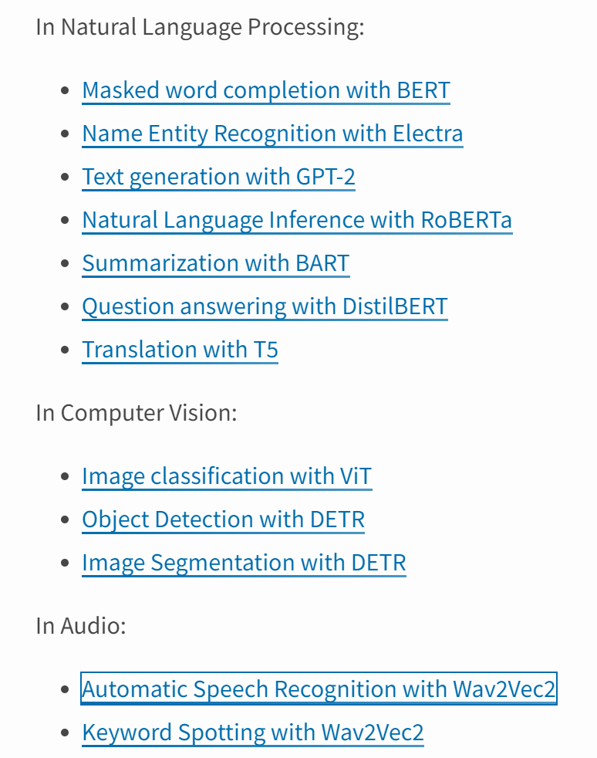
Transformer – Python Library - https://pypi.org/project/transformers/

Slide 49
Chatbot
from transformers import AutoModelForCausalLM, AutoTokenizer
import torch
def load_tokenizer_and_model(model="microsoft/DialoGPT-large"):
tokenizer = AutoTokenizer.from_pretrained(model)
model = AutoModelForCausalLM.from_pretrained(model)
return tokenizer, model
def generate_response(tokenizer, model, chat_round, chat_history_ids):
new_input_ids = tokenizer.encode(input(">> You:") + tokenizer.eos_token, return_tensors='pt')
bot_input_ids = torch.cat([chat_history_ids, new_input_ids], dim=-1) if chat_round > 0 else new_input_ids
chat_history_ids = model.generate(bot_input_ids, max_length=1250, pad_token_id=tokenizer.eos_token_id)
print("DialoGPT: {}".format(tokenizer.decode(chat_history_ids[:, bot_input_ids.shape[-1]:][0], skip_special_tokens=True)))
return chat_history_ids
def chat_for_n_rounds(n=3):
tokenizer, model = load_tokenizer_and_model()
chat_history_ids = None
for chat_round in range(n):
chat_history_ids = generate_response(tokenizer, model, chat_round, chat_history_ids)
if __name__ == '__main__':
chat_for_n_rounds(3)

Slide 50
Optional

Slide 51
With Transformer
from flask import render_template,request
from transformers import pipeline
classifier = pipeline('sentiment-analysis', "mrm8488/bert-small-finetuned-squadv2")
@app.route("/", methods=["GET", "POST"])
def index():
if request.method == "POST":
text = request.form.get("text")
print(text)
r1 = TextBlob(text).sentiment
r2 = classifier(text)
return(render_template("index.html", result1=r1, result2=r2))
else:
return(render_template("index.html", result1="2", result2="2"))
if __name__=="__main__":
app.run()

Slide 52
Requirements.txt
torch @ https://download.pytorch.org/whl/cpu/torch-1.10.0%2Bcpu-cp37-cp37m-linux_x86_64.whl
transformers
gunicorn
numpy
flask
textblob==0.15.3
Runtime.txt
python-3.7.12

Slide 53
Scrapping using BS4
https://www.crummy.com/software/BeautifulSoup/bs4/doc/
import requests
from bs4 import BeautifulSoup
page = requests.get("http://www.facebook.com")
soup = BeautifulSoup(page.content, "html.parser")
print(soup)

Slide 54
Tokenization
from nltk.tokenize import TweetTokenizer
tknzr = TweetTokenizer()
s0 = "This is a cooool #dummysmiley: :-) :-P <3 and some arrows < > -> <--"
tknzr.tokenize(s0)

